Slide 1
进度汇报
胡敬玉
2019.3.13

Slide 2
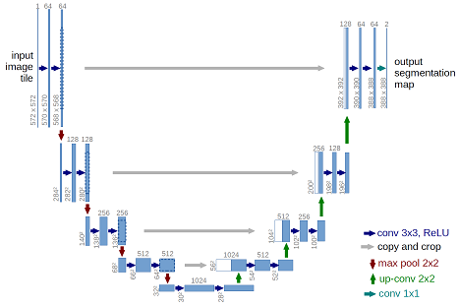
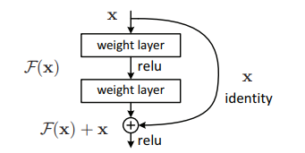
为什么 U-Net 和 ResNet 能够取得出色的结果？
Feature re-use
Skip connection
Drozdzal M, Vorontsov E, Chartrand G, et al. The importance of skip connections in biomedical image segmentation[M]//Deep Learning and Data Labeling for Medical Applications. Springer, Cham, 2016: 179-187.

Slide 3
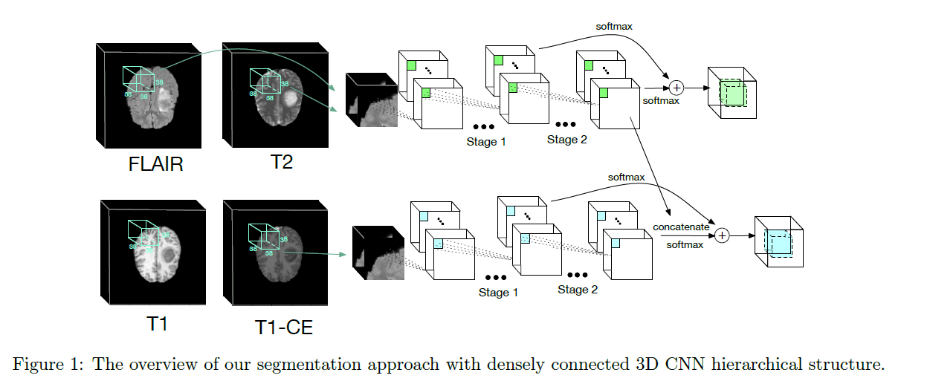
Chen L, Wu Y, DSouza A M, et al. MRI tumor segmentation with densely connected 3D CNN[C]//Medical Imaging 2018: Image Processing. International Society for Optics and Photonics, 2018, 10574: 105741F.

Slide 4
Label 1: necrosis and non-enhancing tumor
Label 2: edema
Label 4: enhancing tumor
Label 0: everything else

Slide 5
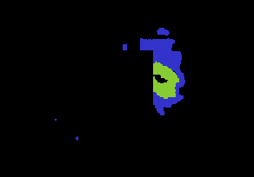
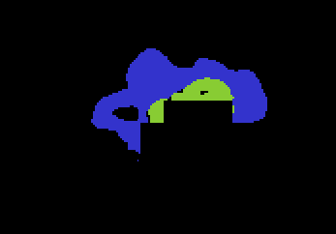
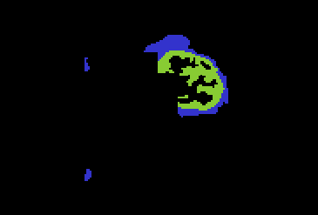
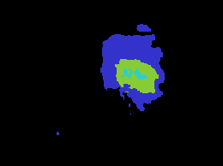

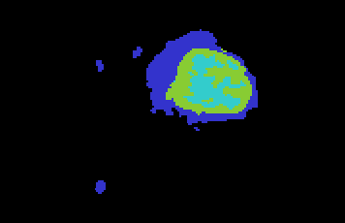
解决的问题
横断面
矢状面
冠状面
修改前
深蓝色：囊肿
浅绿色：增强结构
浅蓝色：坏死部分
修改后
 | Whole Dice | Core Dice | Enhance Dice
修改前 | 0.79 | 0.75 | 0.75
修改后 | 0.88 | 0.83 | 0.82

Slide 6
比较
 | Whole Dice | Core Dice | Enhance Dice
1. DenseCNN (Brats 2017 HGG) | 0.72(0.80) | 0.83(0.75) | 0.81(0.75)
2. Cascade 2PGCNN (Brats 2015) | 0.892 | 0.7918 | 0.751
3. DRINet(Brats 2017) | 0.8347 | 0.7143 | 0.6393
Hybrid_fusion(My proposed)(Brats 2017 HGG) | 0.8775 | 0.8271 | 0.8238
Chen L, Wu Y, DSouza A M, et al. MRI tumor segmentation with densely connected 3D CNN[C]//Medical Imaging 2018: Image Processing. International Society for Optics and Photonics, 2018, 10574: 105741F.
Razzak I, Imran M, Xu G. Efficient brain tumor segmentation with multiscale two-pathway-group conventional neural networks[J]. IEEE journal of biomedical and health informatics, 2018.
Chen L, Bentley P, Mori K, et al. DRINet for medical image segmentation[J]. IEEE transactions on medical imaging, 2018, 37(11): 2453-2462.

Slide 7
后续工作
Dolz J, Gopinath K, Yuan J, et al. HyperDense-Net: A hyper-densely connected CNN for multi-modal image segmentation[J]. arXiv preprint arXiv:1804.02967, 2018.
在Brats 2015 上进行试验

Slide 8
Thank You!

